Slide 2
Binghamton University
EngiNet™
State University of New York

Slide 3
Thomas J. Watson
School of Engineering and Applied Science

Slide 4
WARNING
All rights reserved. No part of the course materials used in the instruction of this course may be reproduced in any form or by any electronic or mechanical means, including the use of information storage and retrieval systems, without written approval from the copyright owner.
©2017 International Business Machines
Binghamton University

Slide 5
CS580Z
(Fall, 2017)
(Tuesday’s and Thursday’s 11:40 to 1:05)
Introduction to the Mainframe: z/VM Basics
Class 12
October 05, 2017
Faculty : Merwyn Jones , Melissa Carlson, Doug Breneman
IBM z/VM Lab Development team
( http://www.vm.ibm.com/ )

Slide 6
Trademarks
The following are trademarks of the International Business Machines Corporation in the United States and/or other countries.
DB2
DS8000*
Enterprise Storage Server*
IBM*
IBM eServer
IBM logo*
System Storage*
System z
System z9
System z10
z9*
z10
z/OS*
z/VM
z/VSE
zSeries*
* Registered trademarks of IBM Corporation
The following are trademarks or registered trademarks of other companies.
Intel is a trademark of Intel Corporation in the United States, other countries, or both.
Java and all Java-related trademarks and logos are trademarks of Sun Microsystems, Inc., in the United States and other countries
Linux is a registered trademark of Linus Torvalds in the United States, other countries, or both.
UNIX is a registered trademark of The Open Group in the United States and other countries.
Microsoft, Windows and Windows NT are registered trademarks of Microsoft Corporation.
Red Hat, the Red Hat "Shadow Man" logo, and all Red Hat-based trademarks and logos are trademarks or registered trademarks of Red Hat, Inc., in the United States and other countries.
* All other products may be trademarks or registered trademarks of their respective companies.
Notes:
Performance is in Internal Throughput Rate (ITR) ratio based on measurements and projections using standard IBM benchmarks in a controlled environment. The actual throughput that any user will experience will vary depending upon considerations such as the amount of multiprogramming in the user's job stream, the I/O configuration, the storage configuration, and the workload processed. Therefore, no assurance can be given that an individual user will achieve throughput improvements equivalent to the performance ratios stated here.
IBM hardware products are manufactured from new parts, or new and serviceable used parts. Regardless, our warranty terms apply.
All customer examples cited or described in this presentation are presented as illustrations of the manner in which some customers have used IBM products and the results they may have achieved. Actual environmental costs and performance characteristics will vary depending on individual customer configurations and conditions.
This publication was produced in the United States. IBM may not offer the products, services or features discussed in this document in other countries, and the information may be subject to change without notice. Consult your local IBM business contact for information on the product or services available in your area.
All statements regarding IBM's future direction and intent are subject to change or withdrawal without notice, and represent goals and objectives only.
Information about non-IBM products is obtained from the manufacturers of those products or their published announcements. IBM has not tested those products and cannot confirm the performance, compatibility, or any other claims related to non-IBM products. Questions on the capabilities of non-IBM products should be addressed to the suppliers of those products.
Prices subject to change without notice. Contact your IBM representative or Business Partner for the most current pricing in your geography.

Slide 7
Windchill Program notes:
if (4<=v<=45) then do
Now why does it work the way it does for the student i.e., why is the expression always true?
REXX evaluates the expression left to right. Choose a number of 1.
  4<1 is false so that is a 0. Then compare 0<45. That is true. The expression is true. Choose a number of 100. 4 < 100. That is true so that evaluates as 1. Then 1 < 45. That too is true.
  So the entire expression is true.
  For all input, the expression is true.

Slide 8
Please issue the following commands from your
BINGTZ1 userid
ACC vmsysu:merwyn. B
This should be in your profile exec

Slide 9
What is CMS Pipelines?
Definition
A Pipeline is a series of programs called stages through which data flows
The output of one stage automatically becomes the input to the next
It is a method of executing a Data Flow diagram

Slide 10
What is CMS Pipelines?
Commonly used from within REXX programs
Sometimes used for quick tasks at the CMS command line
Input can be: Screen Data, Disk, Reader, Stack
Processing can be: Anything!! Sorting, Locating, Counting, Formatting, Modifying etc. etc.
Output can be: Console, Disk, Punch, Stack, Printer

Slide 11
Documentation and Help
CMS Pipelines User’s Guide (SC24-6077)
CMS Pipelines Reference (SC24-6076)
HELP PIPE MENU
HELP PIPE stage

Slide 12
Pipelines Analogy
(Well)
Input
(Water)
Process
(Tap)
Output
Data
Text
<
Count words
Write the
results to the
Console
(or screen)
A Typical program is Input -> Process -> Output
< Reads a file called DATA TEXT Input
Count words Counts the text separated by blanks Process
Console Writes the number of words to the screen Output

Slide 13
Linux Shell Pipelines
CMS Pipelines is similar to the pipeline construct in Linux shells such as bash, but with more functionality

Slide 14
The PIPE Command
Syntax for simple cases:
  PIPE stage_1|stage_2|…|stage_n
The character between stages is the stage separator ‘|’ (by default)
Data in a pipeline flows in one direction, by convention left to right (or top to bottom).
PIPE LITERAL Hello World | CONSOLE
For many stages blanks have no effect, but for some stages (especially LITERAL) they are significant

Slide 15
<
Reads the contents of a CMS file (fn) (ft) (fm)
    Pipe < CRITICAL DATA B | ….. | …..
>>
Reads the input stream and appends the records to a CMS file (creating it if it does not already exist)
Must be not first

Slide 16
LAB 1
1- Pipe Literal Hello World | Console
2- Pipe Literal Hello | > LAB1 RESULTS A
Pipe Literal World | >> LAB1 RESULTS A
TYPE (or XEDIT) LAB1 RESULTS A
3- Pipe Literal Hello| > LAB1 RESULTS A
Pipe Literal World| > LAB1 RESULTS A
TYPE (or XEDIT) LAB1 RESULTS A
4- Write a Pipe to display a file to your terminal (use PROFILE EXEC A, if you can’t think of another file).

Slide 17
Lab 1.4 Possible Solutions
PIPE < PROFILE EXEC A | CONSOLE
PIPE < LAB1 RESULTS A | CONSOLE

Slide 18
Example
Pipe Literal green red blue | Split | > COLORS FILE A
  PIPE < COLORS FILE A | SORT DESCENDING | CONSOLE
  red
  green
  blue
  Ready; T=0.01/0.01 16:19:52
  PIPE < COLORS FILE A | SORT A | CONS * Abbreviations used here *
  blue
  green
  red
  Ready; T=0.01/0.01 16:21:12

Slide 19
Map Diagram:
Read in COLORS FILE A
Sort data in Descending Order
Write Data to Console
Rexx Sample
/* This is a sample in REXX */
‘PIPE’ , /* */
‘ < COLORS FILE A’ , /* Read in colors from a file */
‘| Sort Descending’ , /* Sort data in Descending order */
‘| Console’ /* Write Results to the console */

Slide 20
LOCATE
LOCATE writes records containing a specified target string to the primary output stream
In addition, records not containing the target string are written to the secondary output stream
A range can be specified with the Locate Stage
  Locate 1.8 \<item>\ (locate from column 1 for a length of 8)
  Locate 10-17 \<item>\ (Locate using columns 10 through 17, 8 characters)
  Locate Word-1 \<item>\ (start at the end of the line, take the last word)
  Locate w-1 \<item>\ (same as Word-1, work from the end of the line).

Slide 21
Example
Locate, Split, Strip
PIPE CP Query Names | Split /,/ | Locate /SCOTTB/ | Strip Both | Console
/* QNM EXEC Created by SCOTTB on 09/22/2008 15:07:26 (EST) */
Arg username .
username = 'LEFT'(username,8)
'PIPE',
'| CP QUERY NAMES ', /* Who's on the System */
'| Split /,/ ', /* one user per line */
'| Locate /'||username||'/ ', /* Is person I want on? */
'| Strip Both ', /* Remove lead & trail blanks */
'| Console' /* Write result to terminal */

Slide 22
CP Query Names
Split at the ‘,’
Users that don’t
match locate criteria
Locate the user
User was found
Remove leading and
trailing blanks
Write the results to
the screen

Slide 23
Lab 2:
- Using CMS Pipelines write an exec to see which users, starting with the letter ‘S’ (eg. Sam, Susan) are linked to the 190 disk, sort the list.
Helpful CP commands:
  QUERY LINKS <minidisk>
Helpful Stages (Use Pipe Help <stage>):
  Split, Strip, Locate, Sort

Slide 24
Lab 2 Possible Solution:
/* DSKLINKS EXEC Created by SCOTTB on 09/25/2008 16:37:20 (EST) */
'PIPE ( name DSKLINKS)’ ,
'| CP QUERY LINKS 190’, /* Q minidisk, who's linked */
'| Split /,/ ‘ , /* Separate each link */
'| Strip Leading ' , /* get rid of blanks */
'| Locate 1.1 /S/ ‘ , /* find ‘S’ */
'| Sort 1-8 Ascending’, /* Sort on our criteria */
'| Console' /* Write to the screen */

Slide 25
Lab 2 Possible Solution:
/* DSKLINKS EXEC Created by SCOTTB on 09/25/2008 16:37:20 (EST) */
whatdisk = '190' /* Variables Initialized */
startstring = 'S'
startlength = 'LENGTH'(startstring)
'PIPE ( name DSKLINKS)',
'| CP Q LINKS ' whatdisk , /* Q minidisk, who's linked */
'| Split /,/ ', /* Separate each link */
'| Strip Leading ', /* get rid of blanks */
'| Locate 1.'||startlength||' /'||startstring||'/ ', /* find */
'| Sort 1-8 Ascending ', /* Sort on our criteria */
'| Console' /* Write to the screen */

Slide 26
VAR
If first, reads the value of a REXX variable and writes it to the output stream
If not first, reads the first record from the input stream and sets a REXX variable to that value
Must be used within a REXX exec
Example program:
    /* VARDEMO EXEC */
    animal = ‘cat’
    ‘PIPE VAR animal|CONSOLE’
Example output when vardemo is executed:
    cat

Slide 27
STEM
If first, reads records from a REXX stem and writes them to the output stream
If not first, reads records from the input stream and writes them to a REXX stem
Must be used within a REXX exec
REXX allows a two-part (compound) variable name consisting of a stem followed by a tail, where symbols in the tail are substituted by their values in order to construct the derived name of the compound variable

Slide 28
STEM
The compound variable name is in the format:
    name.tail
The stem is:
    name.
Often the tail is a simple number, as in:
    name.1
STEM reads or writes the set of variables name.0, name.1, name.2, …, name.n
name.0 is the count (or number) of records
name.1, name.2, …, name.n are the records

Slide 29
STEM
Example program:
    /* STEMDEMO EXEC */
    animal.0 = 3 /* For input this value MUST be set */
    animal.1 = ‘cat’ /* For output the <n>.0 is set for you */
    animal.2 = ‘dog’
    animal.3 = ‘rabbit’
    ‘PIPE STEM animal.|CONSOLE’
Example output:
    stemdemo
    cat
    dog
    rabbit

Slide 30
Specs – To Parse or Format Data
Query DASD
DASD 0120 3390 SYE711 R/O 250 CYL ON DASD 595B SUBCHANNEL = 001
DASD 0121 3390 USP773 R/O 75 CYL ON DASD 58E8 SUBCHANNEL = 001
DASD 0122 3390 USE725 R/O 7 CYL ON DASD 59DE SUBCHANNEL = 001
DASD 0190 3390 USE71U R/O 140 CYL ON DASD 5085 SUBCHANNEL = 000
DASD 0191 3390 USE742 R/W 27 CYL ON DASD 50C9 SUBCHANNEL = 000
… … …
111111111122222222223333333333444444444455555555556666666666777
123456789012345678901234567890123456789012345678901234567890123456789012
/* QDASD EXEC Created by SCOTTB at 14:50:12 (EST) on 09/29/08 */
'Pipe' ,
'CP QUERY VIRTUAL DASD |', /* Issue the Query DASD command */
' Spec 6.4 1 |', /* Parse out the information */
' Join 9 / / |', /* Format 10 to a line w/ 2 blanks */
' Console' /* Write it to the screen */
qdasd
0120 0121 0122 0190 0191 0193 0196 019B 019D 019E
019F 01A1 0211 0233 0293 0294 0391 0399 0455 0475

Slide 31
Specs
‘Spec 6.4 1 |’ ,
Spec input <conversion, if used>
Spec usually writes an output record for each input record. The arguments to Spec describe the layout of the output record. Spec can copy the the contents of a column range in the input record to a particular location in the output record. A literal string can be put in a particular location in all output records.
6.4 Take from Column 6 for a length of 4.
1 Output the record starting at column 1
‘SPEC 6-9 1 |’ does the same as 6.4 1
  Take from Column 6 to Column 9 and output the record starting at column 1
Spec Word 2 1 Take word 2 and output the record starting at column 1
Spec W2 1 (Same as above, abbreviated).
Spec Word 3 1 Word 4 NextWord W6 NW
  Take word 3 place it in Column 1
  Take word 4 leave 1 blank (or make it the next output word)
  Take word 6 make it the next output word
Look up Specs (Pipe Help Specs)

Slide 32
/* QFM EXEC created by SCOTTB at 22:01:48 (EST) on 04/25/91 */
arg junk .
rc = 0
If junk = 'HELP' | junk = '?' Then signal Help
say ; say 'File modes Available (or Free for use): '
'Pipe',
' Literal A B C D E F G H I J K L M N O P Q R S T U V W X Y Z',
'| Split ', /* Split up the Literal String */
'| Spec 1.1 13', /* Move to Column 13 to match Q DISK */
'| Append COMMAND QUERY DISK *' , /* Add records from QUERY DISK */
'| Nlocate 8.4 /VDEV/', /* Get rid of records with 'VDEV' */
'| Spec 13.1 1', /* We only want the filemodes */
'| Sort ', /* Sort filemodes with the literals */
'| Unique Single ', /* If 2 exist discard them (in use) */
'| Join * / /', /* Put on one line with a blank */
'| Var freemodes' /* Place results in variable freemodes*/
say ' ' freemodes ; say
Exit rc
Help:
'VMFCLEAR'
say ; say ' Syntax = QFM '
say ' This exec will show you : '
say ' -) File-modes Available for use. '
say ; say ' The output of this exec will look like : '
say ; say ' File modes Available (or Free for use): '
say ' D E H I J K L M O P V W X Z '
say ; Exit rc

Slide 33
Homework
Issuing the command:
Query Time results in the following information being displayed to the screen:
TIME IS 21:50:01 EDT MONDAY 10/06/08
CONNECT= 03:06:48 VIRTCPU= 000:00.12 TOTCPU= 000:00.15
Write a DT EXEC (date, time) to do the following:
Please reformat this data using Specs to show only the following:
  Time
  Date: Change the ‘/’ to a ‘-’
  Make the date a four-digit year (assume 20xx)
Your output (based on the above example) should look like:
21:50:01 10-06-2008

Slide 35
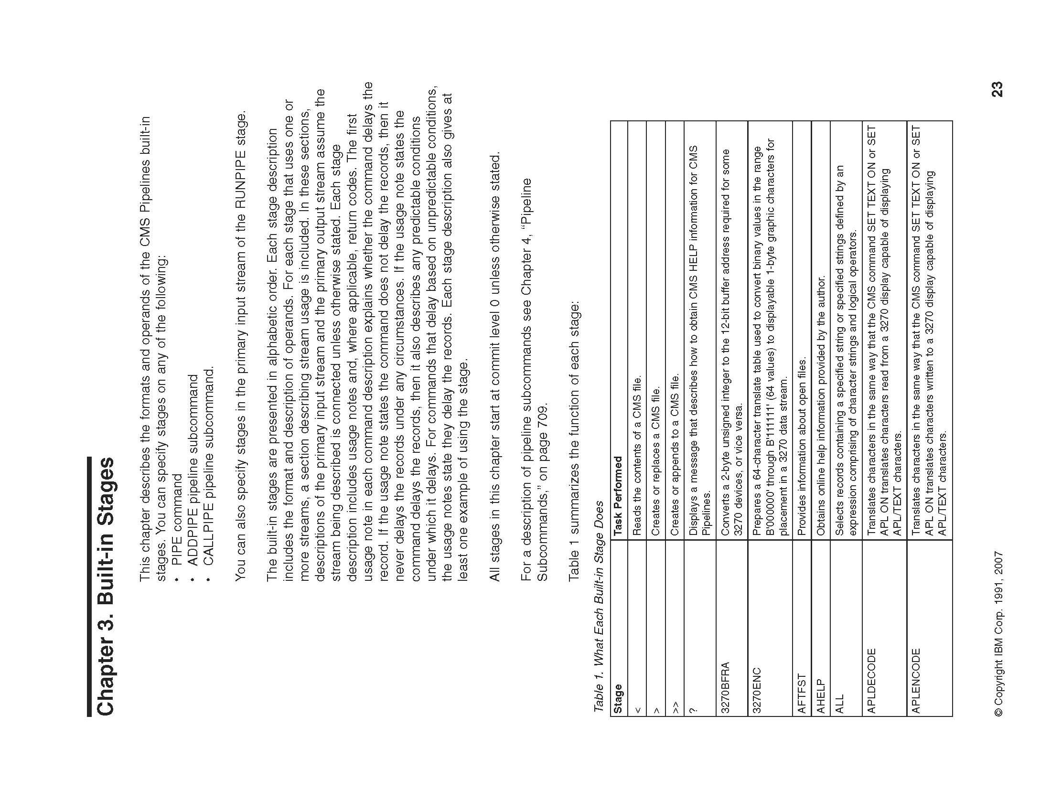

Slide 36
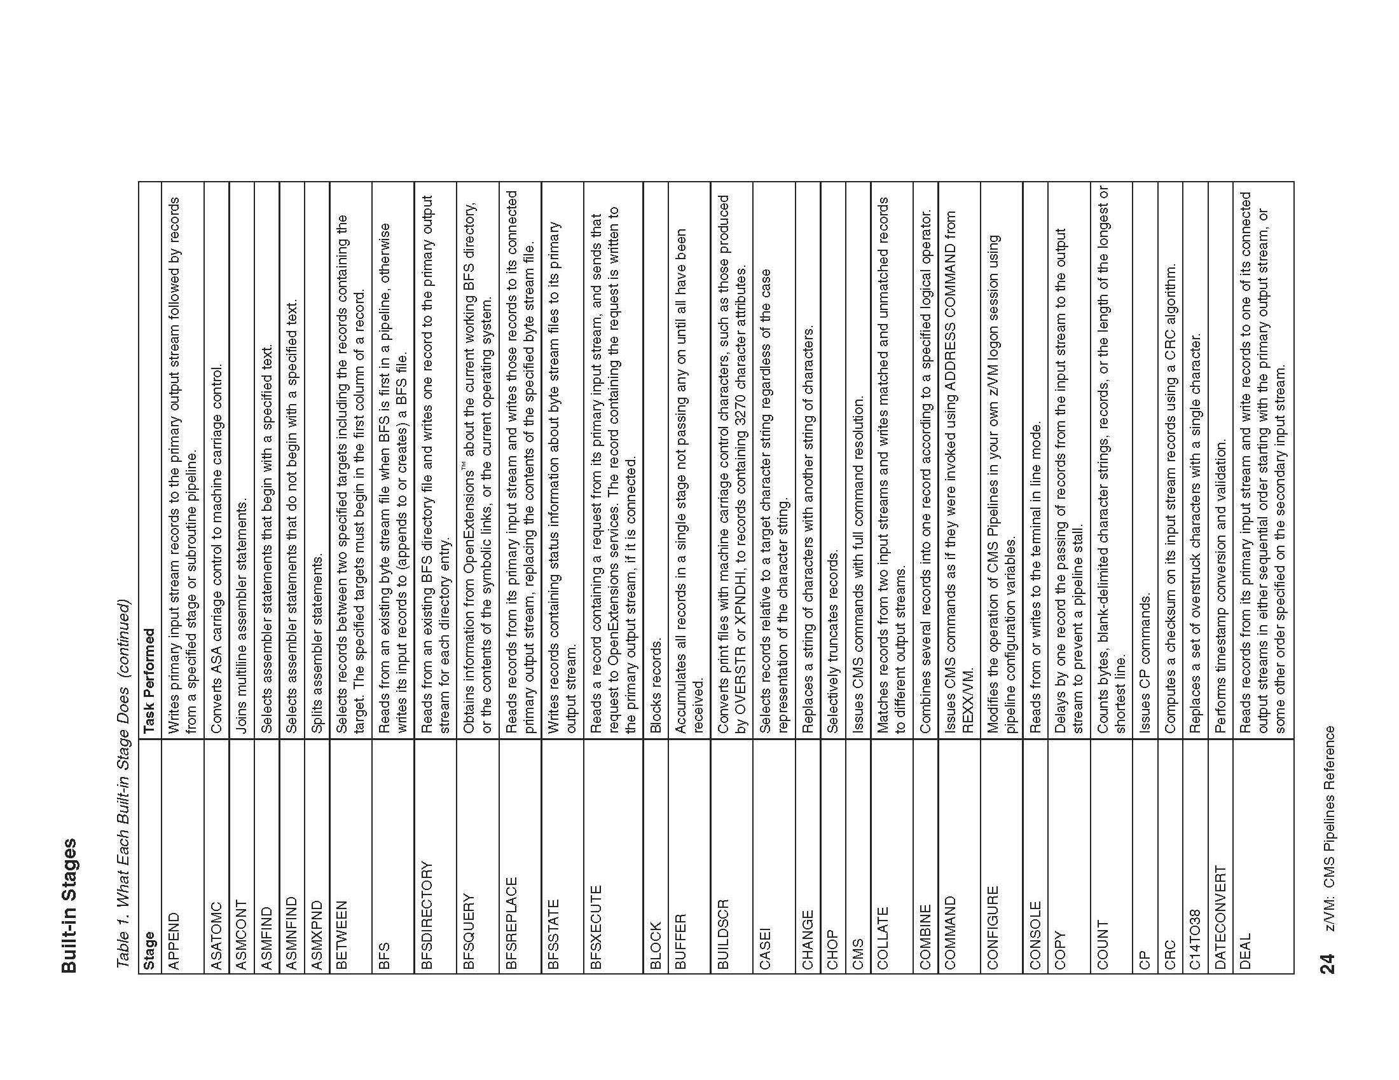

Slide 37
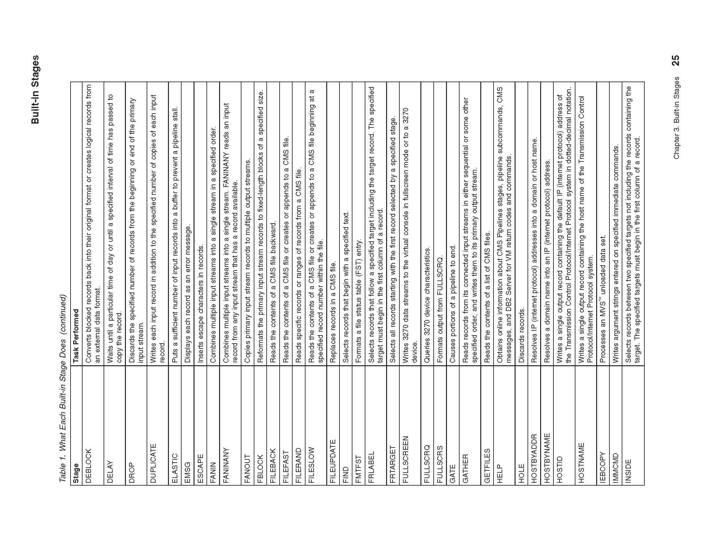

Slide 38
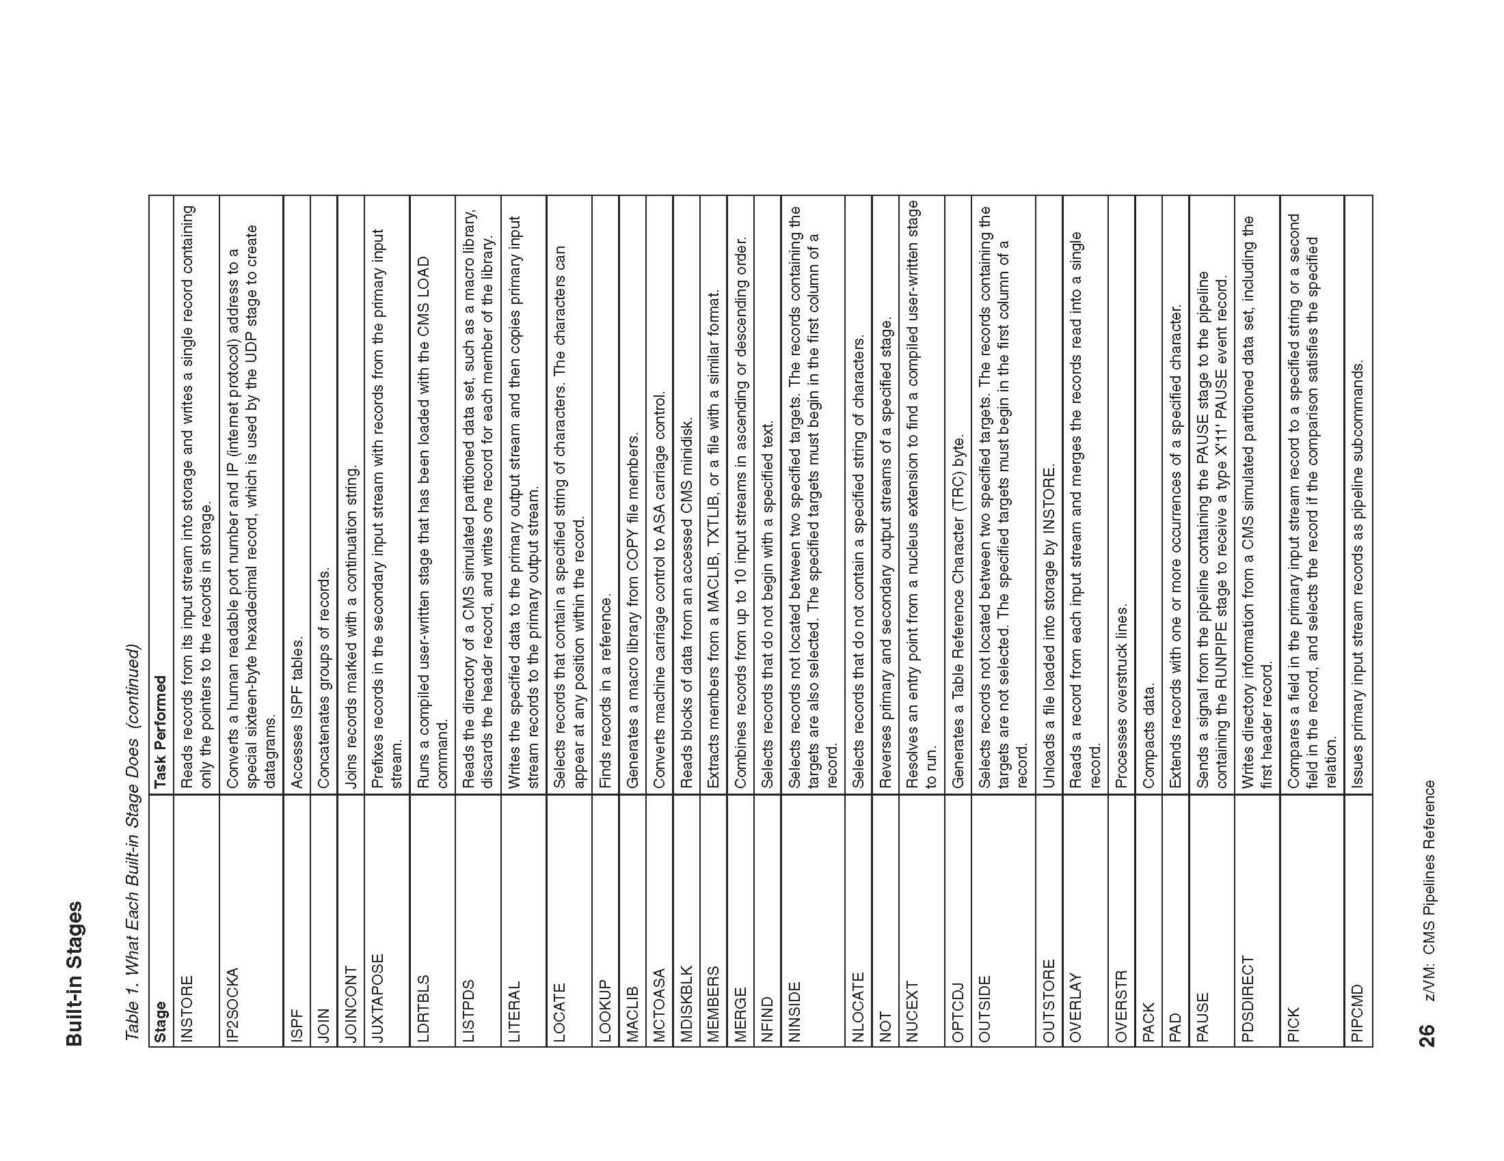

Slide 39
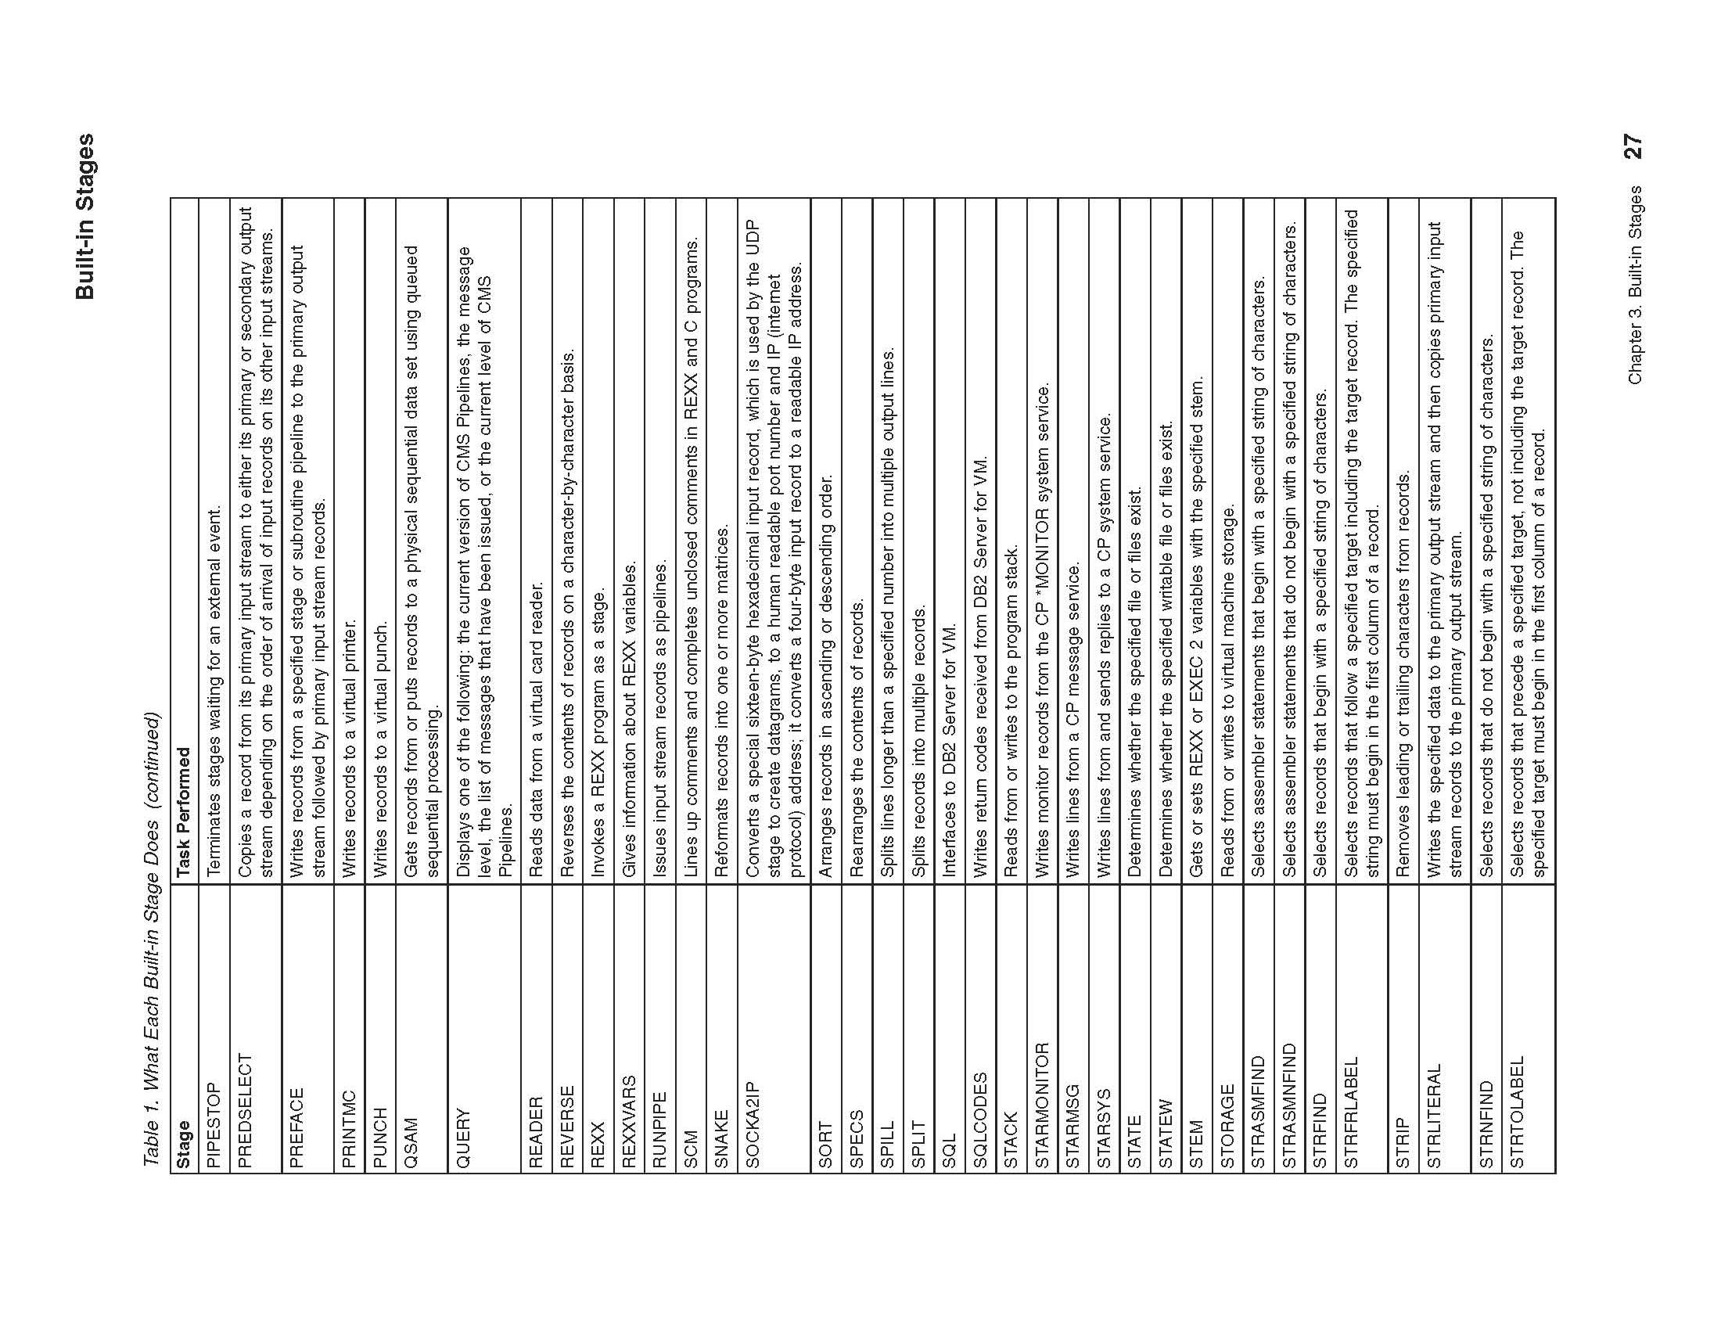

Slide 40
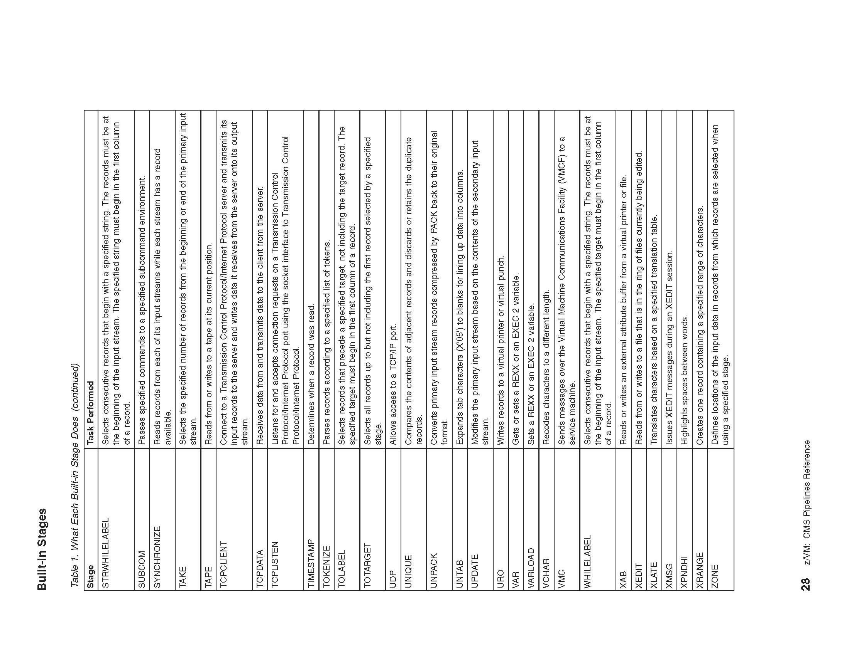

Slide 41
